Slide 1
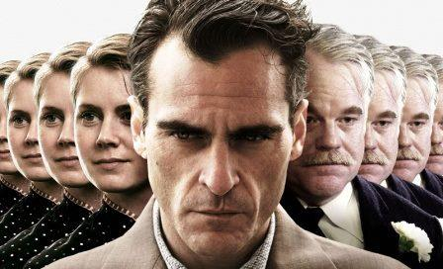
Basic approaches to human resource management

Slide 2

Questions:
Economic approach.
Organic approach.
Humanistic approach

Slide 3

Recommended reading:
Summary:
1.Армстронг М. Стратегическое управление человеческими ресурсами/перевод с анг. - М.: Смысл, 2012.
2.Armstrong M. (2006). Strategic human resource management. Typeset by Caxon graphics Ltd.
3. Arthur D. Fundamentals of Human Resources Management.fourth edition. Amacom, 2011.
4. Бакирова Г.Х. Управление человеческими ресурсами. – СПб.: Речь, 2010.
5.Бакирова Г.Х. Тренинг по управлению персоналом. СПб.: Речь, 2011.
6..Базаров Т.Ю. Управление персоналом. Практикум. – М.:ЮНИТИ-ДАНА, 2013.
7.Барбара Арт. Bersin & Associates © 2011. High-Impact Leadership Development for the 21st Century (Part 1): Key Findings, Trends and Analytics.
8.Борисова Е.А. Оценка и аттестация персонала. – СПб: Питер, 2013.
9.Дубинская Е.Н.Техники подбора персонала. - СПб.: Речь, 2012.
10.Blancero D., Boroski J., Dyer L. Key competencies for a transformed human resource organization: results of a field study // Human resource management. - 2011. Vol.35. - № 3.
11.Stewart G., Brown K.G. Human Resource Management. Linking strategy to practice. Wiley, 2010.
Further Reading
1.Базаров Т.Ю. Технология центров оценки персонала: процессы и результаты. - М.: Кнорус,
2.Дубинская Е.Н.Техники подбора персонала. - СПб.: Речь, 2012.
3.Кибанов А.Я. Управление персоналом. Учебник. - М.: ИНФРА-М, 2012.
4.Ковалев С.В. Работа с персоналом. – М.: Альфа-Пресс, 2008.
5.Почебут Л.Г., Чикер В.А.Организационная социальная психология. - СПб.: Речь, 2010.
6.Практикум по психологии менеджмента и профессиональной деятельности/под ред.Г.С.Никифорова, М.А.Дмитриевой и др. - СПб.: Речь, 2013.
7.Becker G.S. (2011) Human capital: Theoretical and Empirical Analysis. - N-Y., 2011.
Internet resources.
www.nasoup.com. http://www.azps.ru
http://www.top-personal.ru
http://www.hrm.ua
http://www.hrm.ru
http://www.prenhall.com/desslertour/chapter3.pdf

Slide 4
Economic approach
The economic approach to management has given rise to the concept of use of a manpower.
Within the limits of this approach the leading place occupies technical (i.e. Directed on mastering by lab our receptions), instead of administrative preparation of people at the enterprise.
The organization here means orderliness of relations between clearly outlined parts whole, having a certain order.
The organization is a set of mechanical relations, and to operate it should like the mechanism: effectively, reliably and predictably.

Slide 5
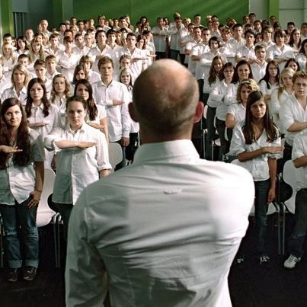
The main principles of the concept of labor resources
Maintenance of unity of a management - subordinates receive orders only from one chief;
Observance of a strict administrative vertical - a chain of management from the chief to the subordinate goes down from top to down on all organisation and is used as the channel for communications and decision-making;
Fixation of necessary and sufficient volume of the control - number of the people, subordinated to one chief, should be such that it did not create a problem for communications and coordination;
Observance of clear split of staff and linear structures of the organisation - the staff personnel, being responsible for the activity maintenance, under no circumstances cannot carry out imperious powers by which linear heads are allocated;

Slide 6
Balance achievement between the power and responsibility - is senseless to do someone responsible for any work if corresponding powers are not conferred to it;
Discipline maintenance - submission, sense of duty, energy and display of external signs on respect should be carried out according to the accepted rules and customs;
Achievement of submission of individual interests to a common cause by means of hardness, a personal example, fair agreements and the constant control;

Slide 7
Organic approach
Within the limits of an organic paradigm have consistently developed the concept of management of the personnel and the management concept human resources.
The organizational approach has designated new prospect of management of the personnel, having deduced this type of administrative activity is far for frameworks of traditional functions of the organization of work and the salary.
Personnel function from registration-control gradually became developing and has extended on search and selection of workers, planning of career of significant figures for the organization, an estimation of workers of administrative personnel, increase of their qualification.

Slide 8
The first organizations starting with an identification with the human person, has entered into a scientific turn such key concepts, as the purposes, requirements, motives, and also a birth, a growing, ageing and death or organization revival.
The second, having accepted as the sample for the description of an organizational reality functioning of a human brain (“the organization as a brain processing the information”), has allowed to look at the organization as on meeting of the parts connected by lines of management, communications and the control.

Slide 9
Humanistic approach
The humanistic paradigm developing recently starts with the concept of management of the person and from representation about the organization as a cultural phenomenon.
The organizational culture - complete representation about the purposes and the values inherent in the organization, specific principles of behavior and ways of reaction, becomes one of explanatory principles.
Thus the culture is considered through a prism of corresponding standards of the development reflected in system of knowledge, ideologies, values, laws and daily rituals, external in relation to the organization, social communities.
Influence of a cultural context on management of the personnel is represented today quite obvious.
For example, in Japan the organization is considered not as a workplace uniting separate workers, and as collective.
For such organization the spirit of cooperation, interdependence are characteristic; lifelong hiring transforms the organization throughout a family; between chiefs and subordinates are established paternalistic relations.

Slide 10

Thank you for your attention

